Slide 1
Project 1: Group 12
Project Team:
Caleb Meinke, Luisa Murillo,
Gavin Bozan, and Charles Arnold

Slide 2
Project: Dataset | Introduction & Inspiration
Dataset:
Financial Transactions Dataset: Analytics
https://www.kaggle.com/datasets/computingvictor/transactions-fraud-datasets/code
Introduction:
The “Financial Transactions Dataset: Analytics,” contains financial payment card and card holder demographic information from 2010 through 2019.
Notes:
Talking points: - Dataset is comprised of multiple CSVs: One containing individual customer attributes and another containing payment transaction attributes
These files required merging on the client ID of each individual customer
Data cleansing – removing dollar signs from monetary values
Reverse geocoding for state extract
Added columns for DTI, State, state lat/long
The dataframe contained approximately 1,700 individual client IDs after merging and outlier elimination
The dataset is fictious, which limits its real-world use; however, inspiration for our effort came from multiple resources:
Post-pandemic focus on consumer spending, inflation, and debt are top of mind
Similar studies conducted by other organizations including
Center for Economic and Policy Research study, “Before and After the Pandemic: Income Volatility, Health Care Affordability, and Debt”
Financial Health Network’s study, “Financial Health Pulse 2023 U.S. Trends”

Slide 3
Objectives
Explore financial health on how it varies with:
Select demographics
Individual financial attributes
Geographic regions
Analyze the correlations between the above characteristics and established measurement of financial health, know as the total debt-to-income (DTI) ratio
Notes:
Talking Points:
Various forms of the debt-to-income ratio are used in the financial industry
The DTI is used to measure general financial health, creditworthiness, and financial stress
This is a known consideration in lending, credit scoring, and risk assessment.
This ratio provides a glance at individual debt payment obligations compared against income to determine financial health
Our analysis sought to use the DTI to test the following hypotheses:
Alternative: Customer demographics including age, gender, and income influence individual financial health (as measured by the DTI)
Null: Customer demographics including age, gender, and income have no impact on individual financial health (as measured by the DTI)
Alternative: Individual financial attributes including total debt, total card count, and credit score influence individual financial health (as measured by the DTI)
Null: Individual financial attributes including total debt, total card count, and credit score have no impact on individual financial health (as measured by the DTI)
Alternative: Customer geographic information including state, region, and per-capita-income influence individual financial health (as measured by the DTI)
Null: Customer geographic information including state, region, and per-capita-income have no impact on individual financial health (as measured by the DTI)

Slide 4
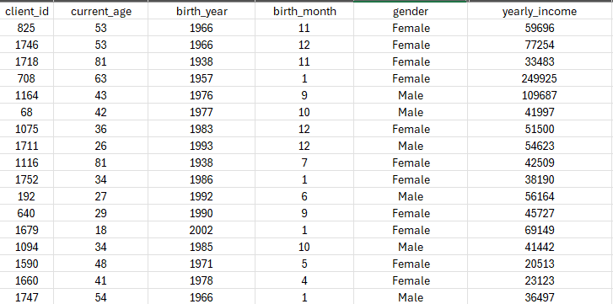
Customer Demographics
QUESTION 1: How do customer demographics (e.g., age, gender, income) correlate with customer financial health?

Slide 5


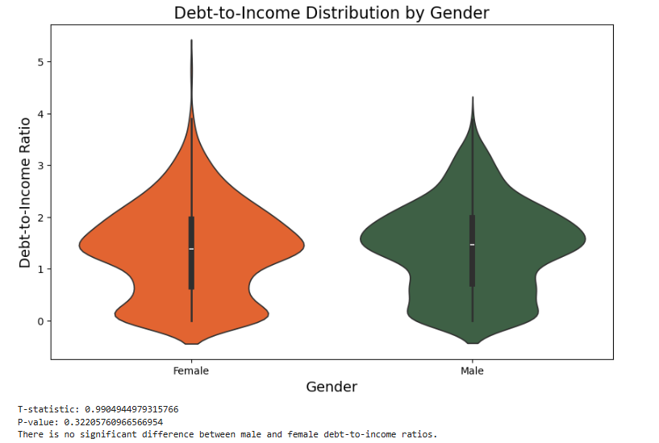
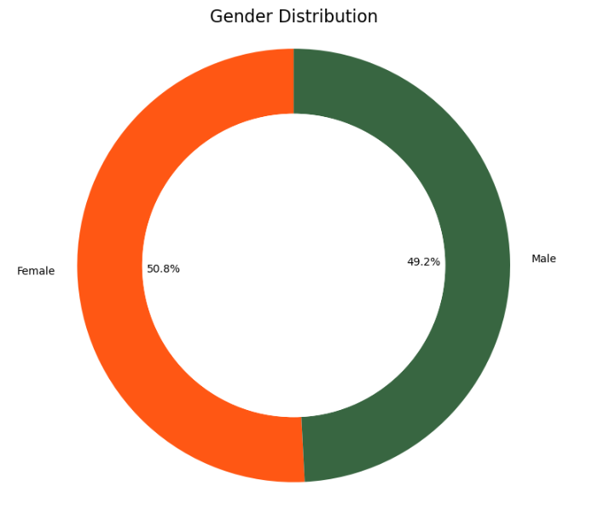


Slide 6
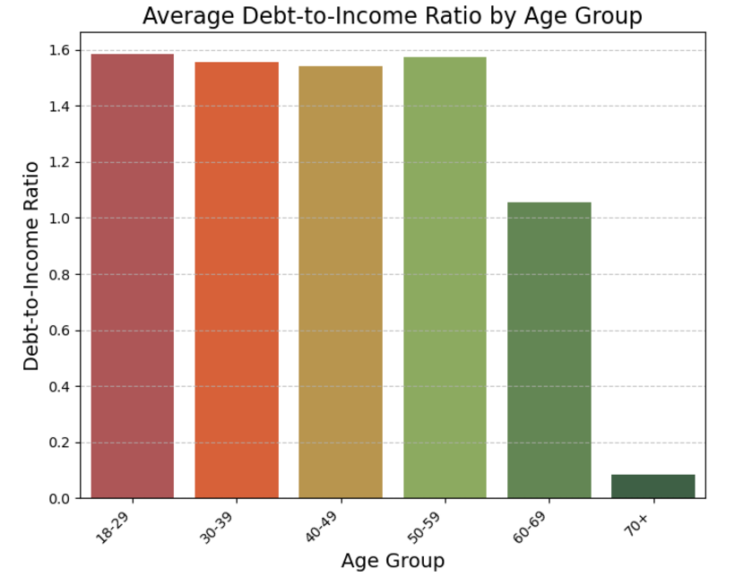

Slide 7
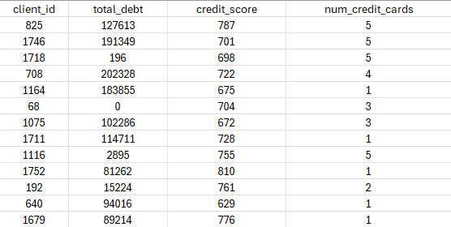
Financial Attributes
QUESTION 2: How do financial attributes (e.g., card count, credit score, total debt) correlate with customer financial health?

Slide 8
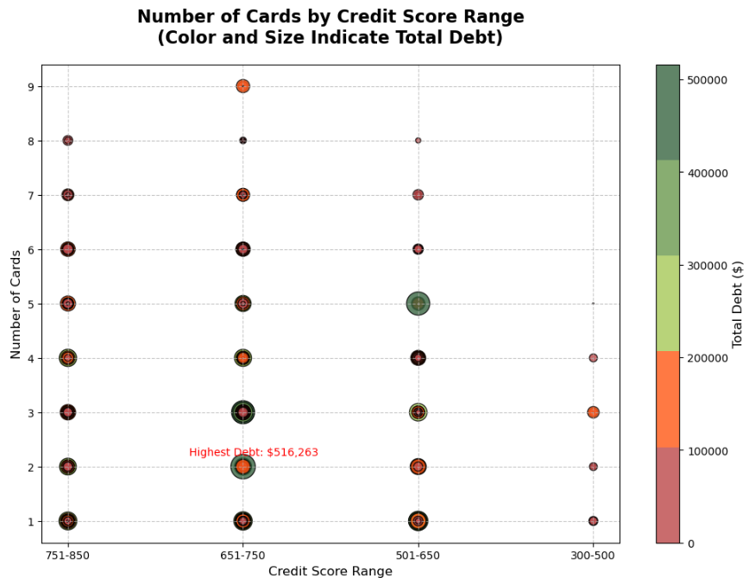

Slide 9
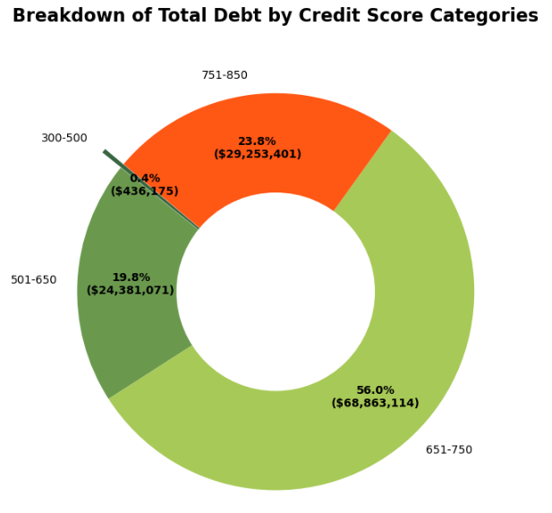
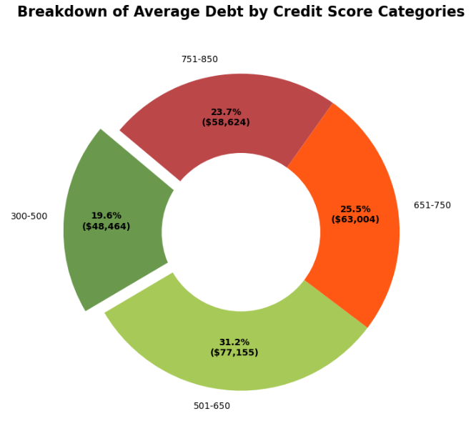

Slide 10
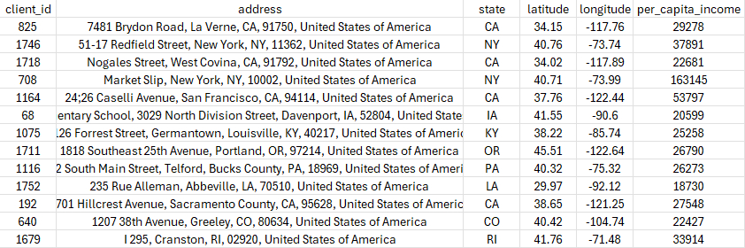
Geographic Information
QUESTION 3: How does customer geographic information (e.g. state, city, per capita income) correlate with customer financial health?

Slide 11
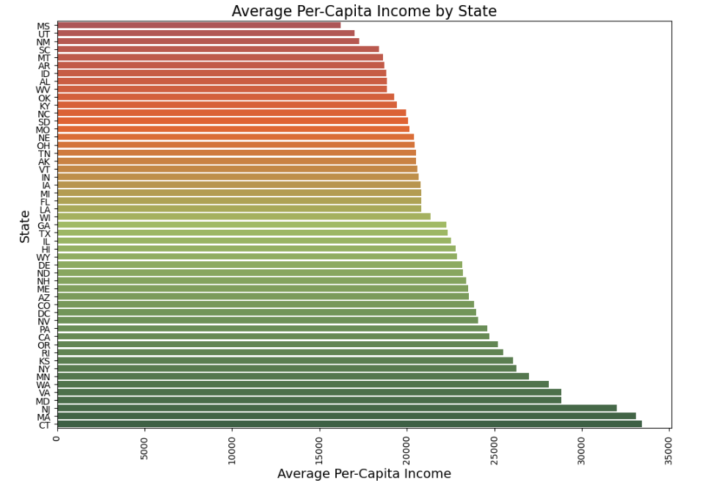
Notes:
Speaking points: Looking at average per-capita income by state shows a clear geographical difference in incomes.
This is a known factor from other studies that look at regional income and cost of living (used in wage assignments, benefit allocations, and other financial assessments
The team’s assumption was that states and regions with lower per-capita income may rely on debt spending more than regions with notably higher per-capita-income, which would result in a higher DTI.

Slide 12
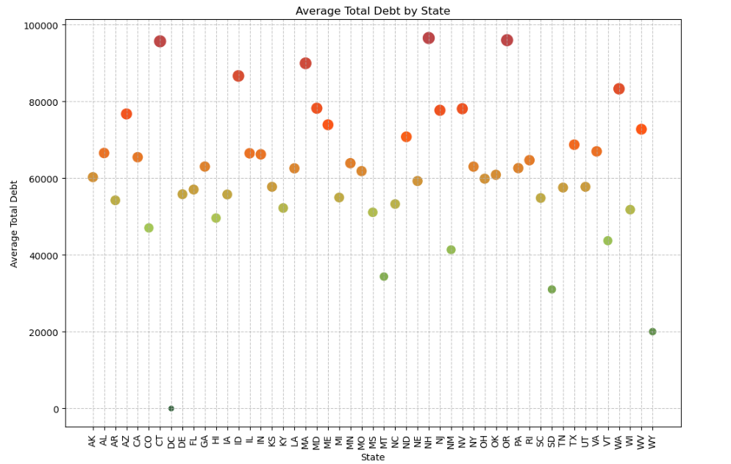
Notes:
Speaking notes: Initial assessment looked at debt by state, using the dataframe population with debt and income outliers removed to smooth the data.
- The gradient shows highest total debt (red) to lowest total debt (green) across the scatterplot across

Slide 13
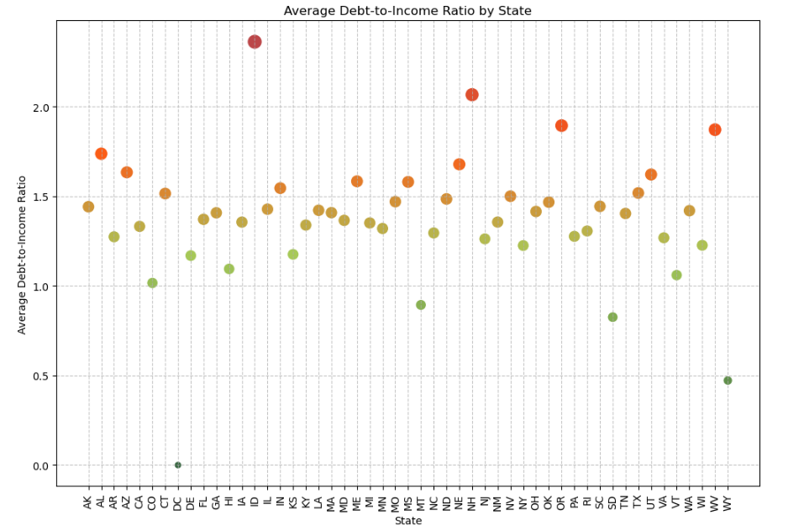
Notes:
Speaking notes: Secondary assessment looked at DTI by state, using the dataframe population with debt and income outliers removed to smooth the data.
The gradient shows highest DTI (red) to lowest DTI (green) across the scatterplot across
The DTI view tightened the variance between the population of states, and served as our geographic plot

Slide 14
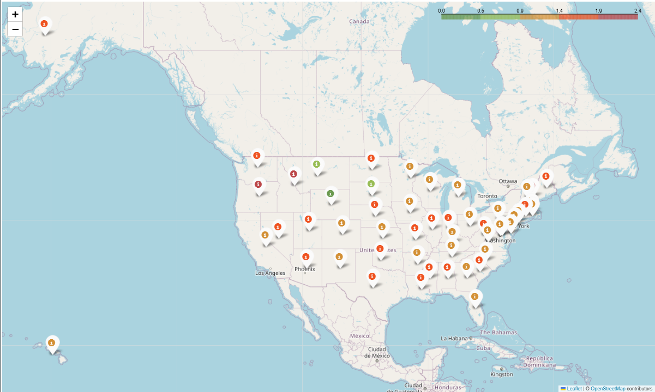
Average Debt-to-Income (DTI) by State
Notes:
Speaking notes:
Plotting DTI by state geographically did not show any apparent geographical relationship to DTI.
There was relatively even distribution of high and low DTI across the map
The only exceptions observed were in the northern plains region (MT, WY, SD) and the East Coast Metro region (PA, NY, NJ, and surrounding states)
The northern plains region showed a grouping of low DTI states. This may be a result of small sample sizes for these states, however.
The East coast metro region showed DTI more consistently around the median of DTI by state
Both would require further investigation to prove out, however.

Slide 15
Bias and Limitations
Limitations:
Fictitious data – Use for exercise
Some states had very small sample size
Bias:
Distribution of Male(49.2%)to Female (50.8%)
Wasn’t a 50/50 split but is Reflective of US Population
# of outliers impacted ‘gold standard of measurement’ (e.g. Age, State, DTI Ratio)
Removed outliers in total debt and yearly income to ensure that the DTI was smoothed out
May have unintentionally created bias by being selective of the outliers we removed

Slide 16
Regression Analysis

Slide 17
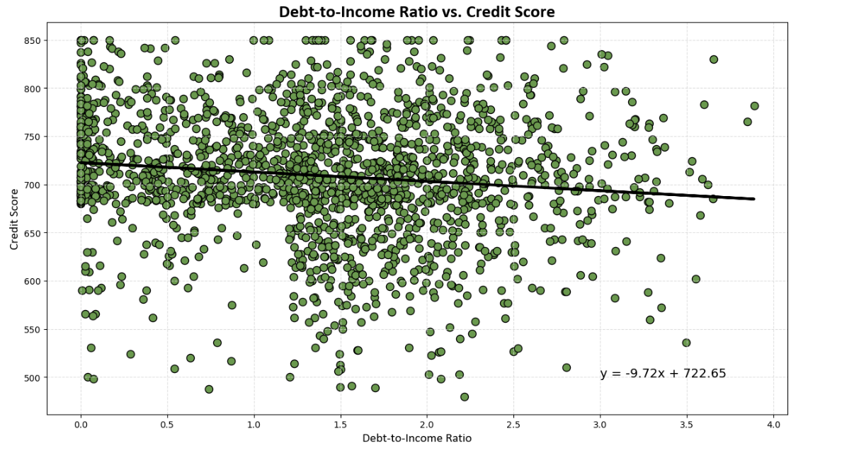

Slide 18
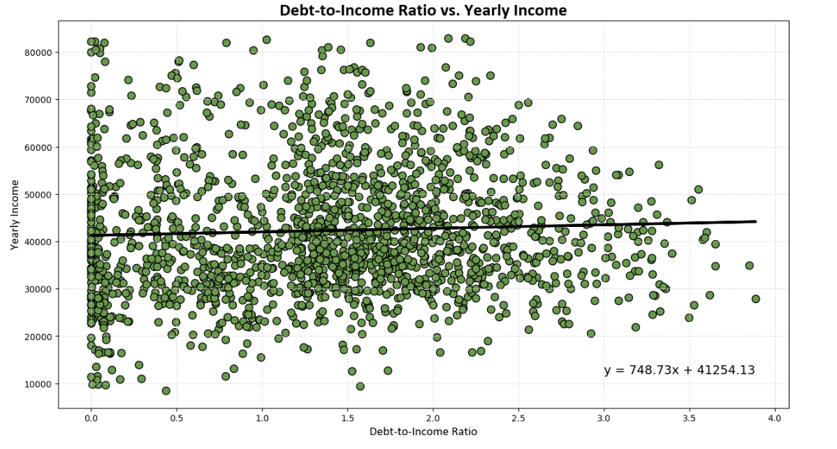

Slide 19
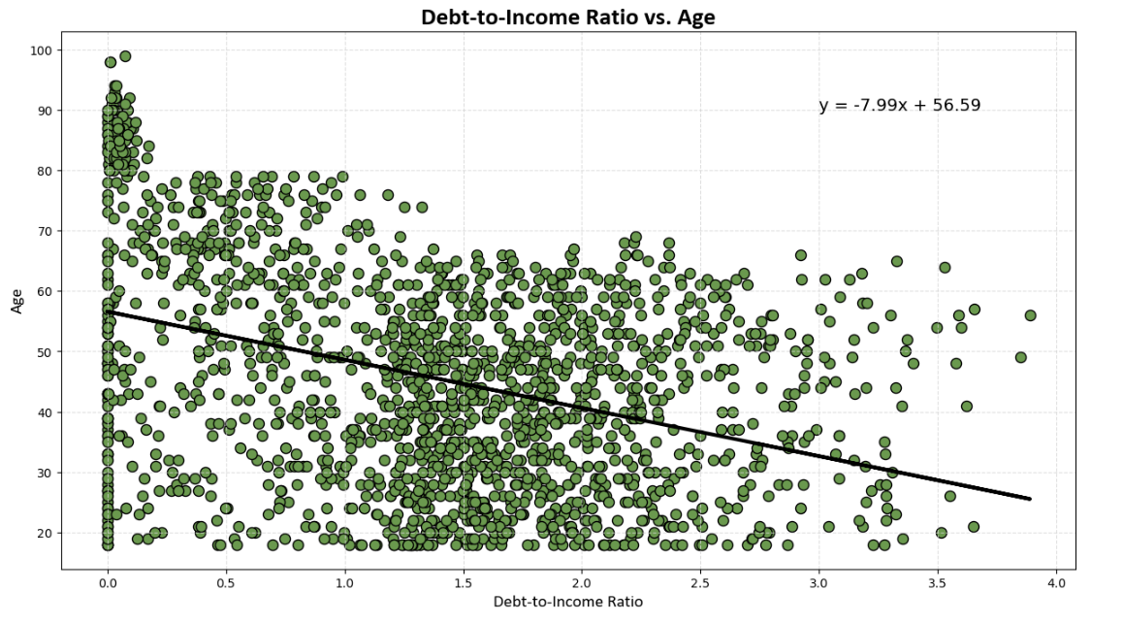

Slide 20
Conclusion|Final Thoughts
Debt-to-Income (DTI) ratio impact:
Credit Score
Yearly Income
Age
The only correlation that exists is between DTI and Age
As you mature in life your debt-to-income ratio lower, doesn’t matter income, credit score
Expected to see that the lower the income the higher the debt-to-ratio

Slide 21
Thank You!

Slide 22
Works Cited
Financial Transactions Dataset: Analytics
https://www.kaggle.com/datasets/computingvictor/transactions-fraud-datasets/code
Kaggle: Introduction to Folium
https://www.kaggle.com/code/imdevskp/folium
ChatGPT – Python AI Assistance
https://chatgpt.com/

